Slide 1
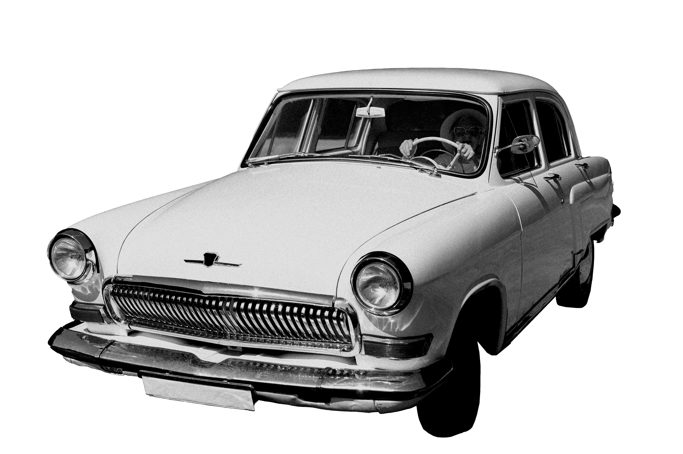
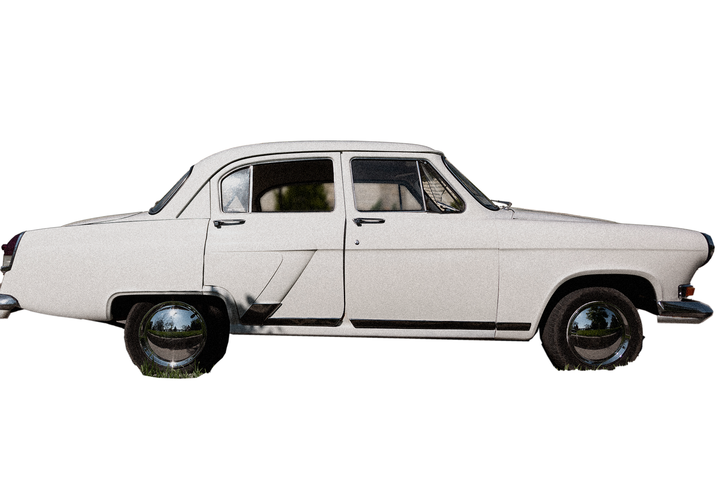
Optimising Parking Solutions: Leveraging OpenCV for Advanced Image Processing in Space Detection
T..JEEVAN SAI - 192225037
J.MAHENDRHA - 192225062
K.CHRIS NICHOLAS VACHAN DEEP - 192225043

Slide 2
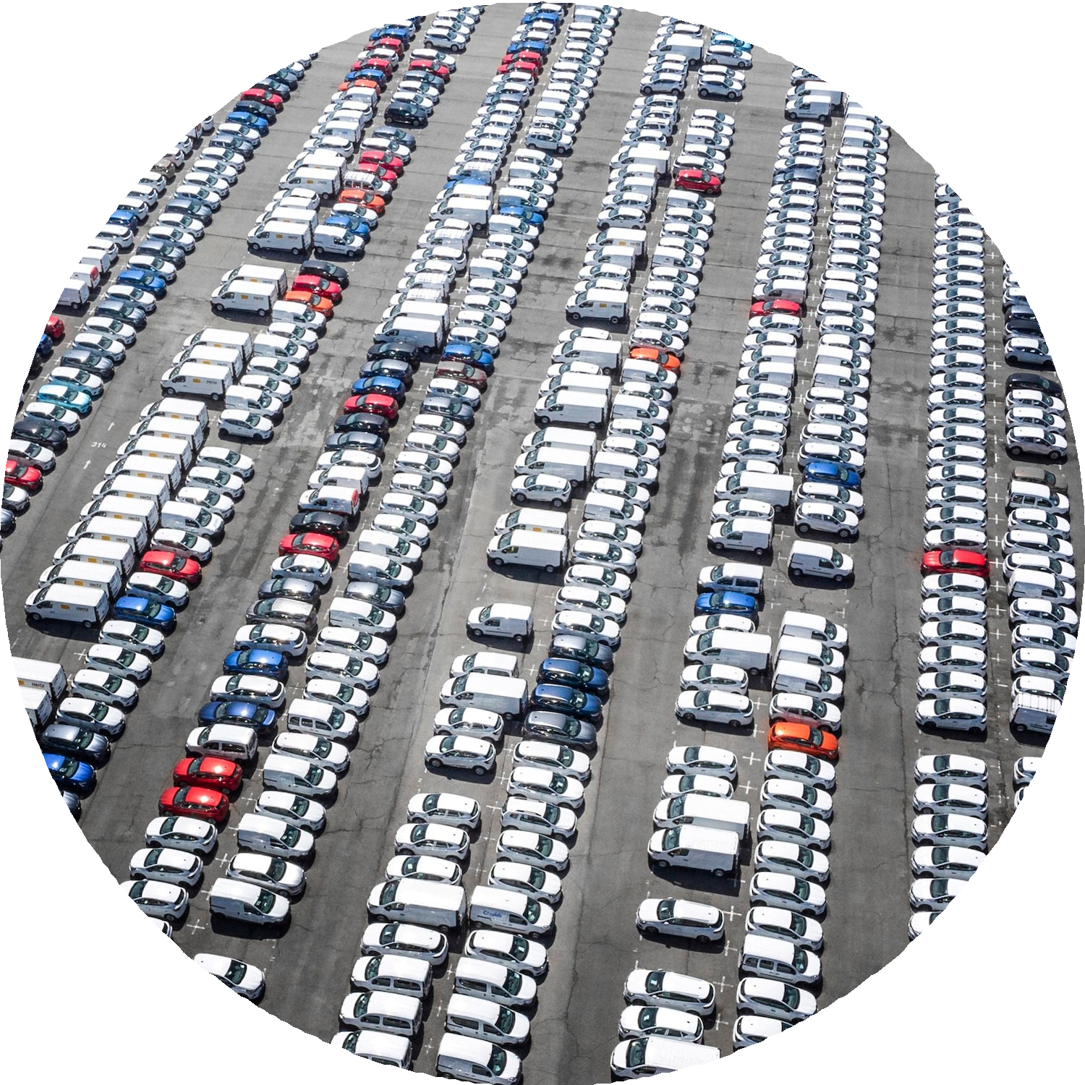
Introduction to Parking Solutions
In today's urban environment, eﬃcient parking is crucial. This presentation explores how OpenCV can enhance image processing techniques for space detection. By leveraging these technologies, we can optimize parking solutions, reduce congestion, and improve user experience.

Slide 3

Understanding OpenCV
OpenCV (Open Source Computer Vision Library) is a powerful tool for real-time image processing. It provides a comprehensive suite of functions that allow developers to implement computer vision tasks, making it ideal for parking space detection applications.

Slide 4
Image Processing Basics
Image processing involves manipulating images to extract useful information. Key techniques include ﬁltering, thresholding, and contour detection. These methods are essential for identifying available parking spaces and ensuring accurate detection.

Slide 5
Space Detection Techniques
Eﬀective space detection requires advanced techniques like edge detection and object recognition. By applying these methods, we can accurately identify empty parking spots in real-time, signiﬁcantly enhancing parking management systems.

Slide 6
Real-Time Processing Challenges
Processing images in real-time poses challenges such as lighting variations and dynamic environments. Utilizing OpenCV's capabilities, we can develop robust algorithms that adapt to these conditions, ensuring reliable space detection.

Slide 7

Implementing Solutions
To implement eﬀective parking solutions, developers can integrate OpenCV with machine learning techniques. This combination enhances the accuracy of space detection and allows for predictive analytics in parking management systems.

Slide 8
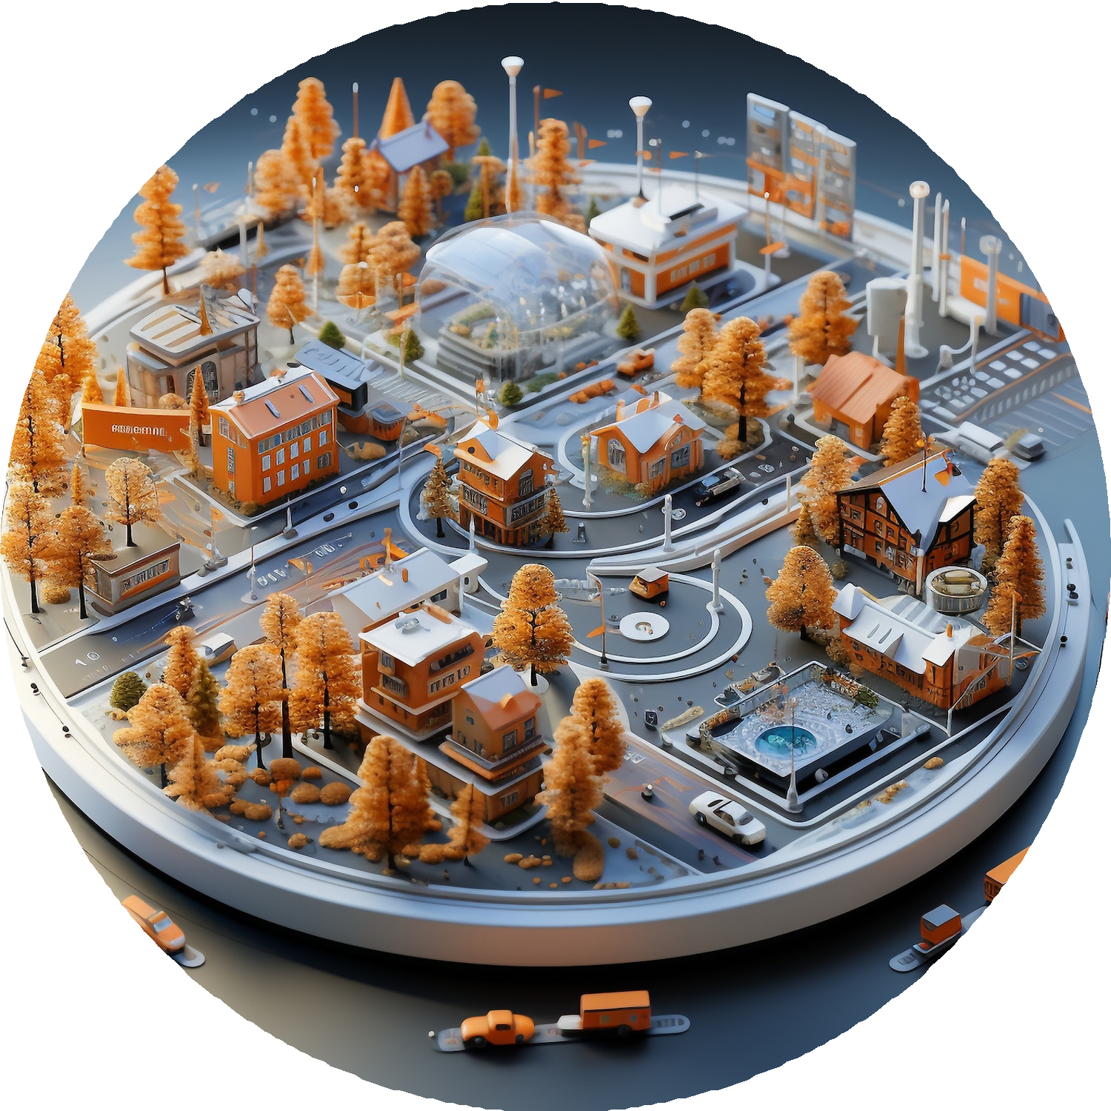
Case Studies
Several cities have successfully implemented OpenCV-based parking solutions. These case studies demonstrate signiﬁcant improvements in space utilization, reduced search times, and increased user satisfaction, showcasing the practical beneﬁts of this technology.

Slide 9
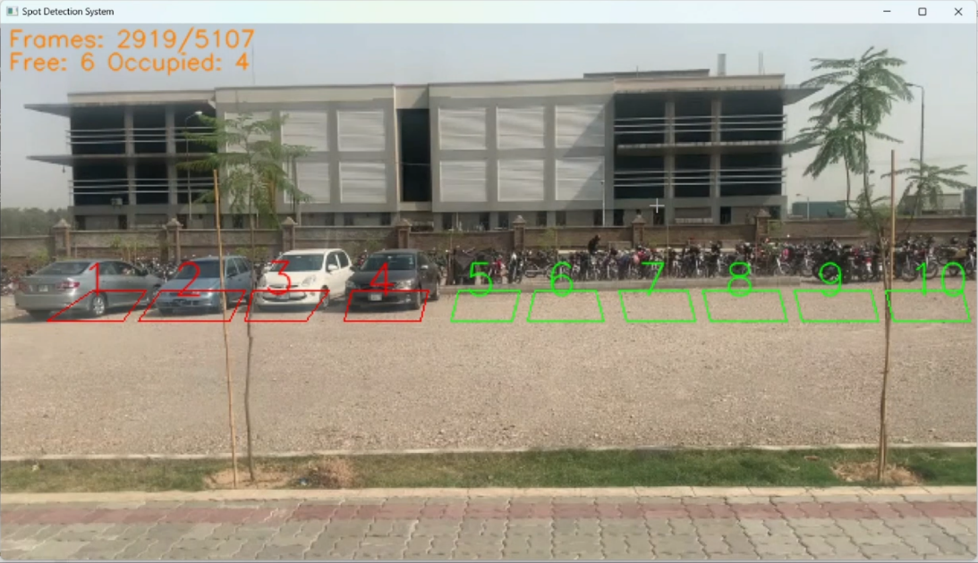
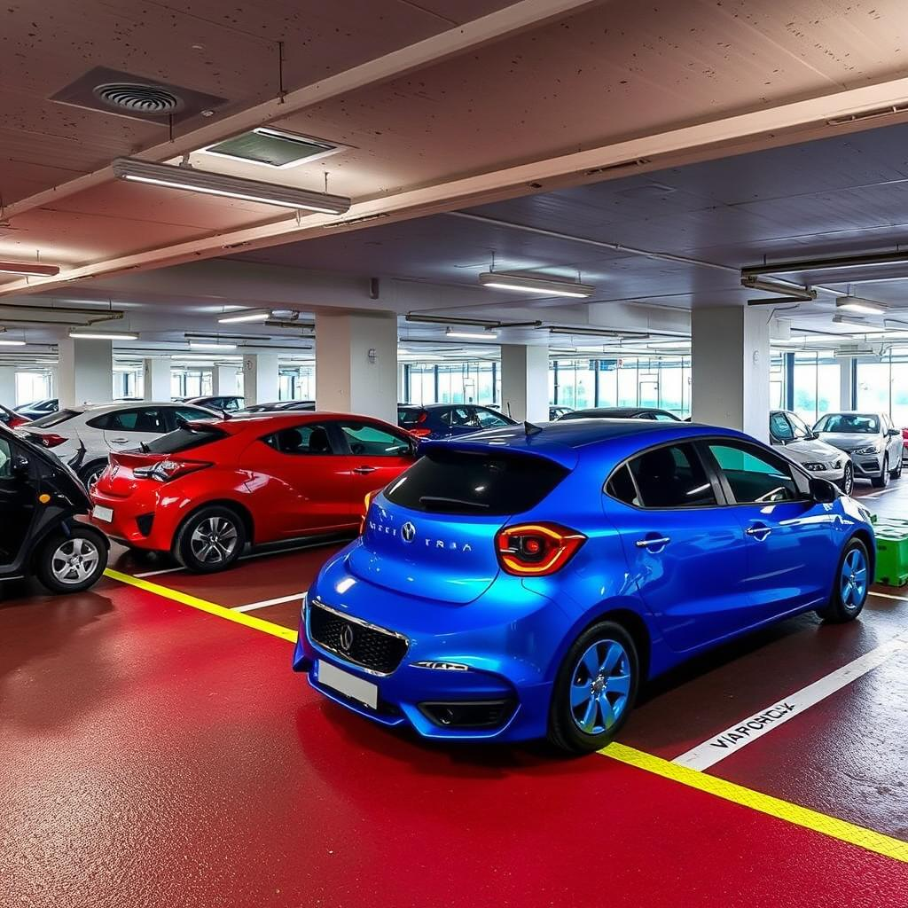
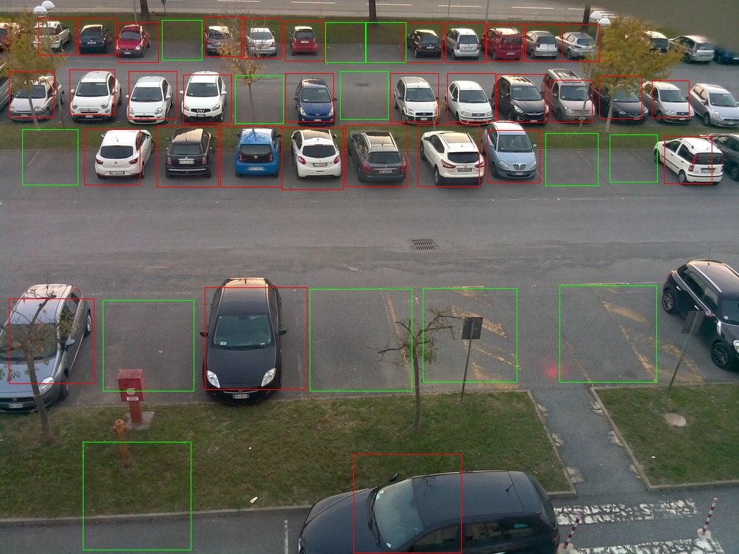
DYNAMIC ENVIRONMENT :

Slide 10
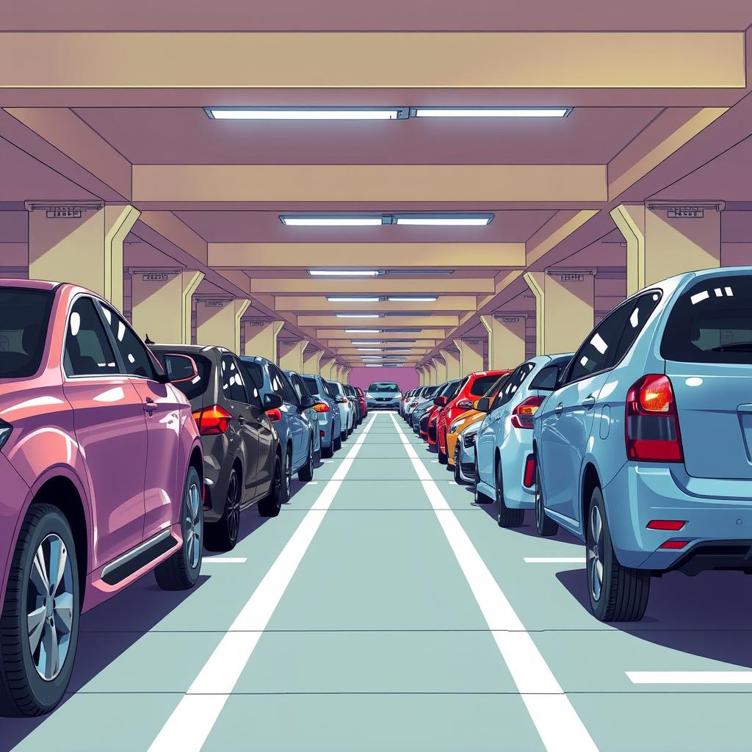
Conclusion
Optimizing parking solutions through OpenCV and advanced image processing is a transformative approach. By embracing these technologies, cities can improve parking eﬃciency, reduce congestion, and enhance the overall urban experience for residents and visitors alike.

Slide 11

Thank You!

